Slide 1
How successful is Singapore’s efforts in enhancing the efficiency of the nation’s land public transport?
Analysis Done By: Toh Kien Yu (P2222291)

Slide 2
Objectives of this Analysis
Objective 1: What is the current state of Singapore's land public transport situation like ?
Objective 2: What are the steps that Singapore has taken to improve the comfort and accessibility of its public transport system?

Slide 3
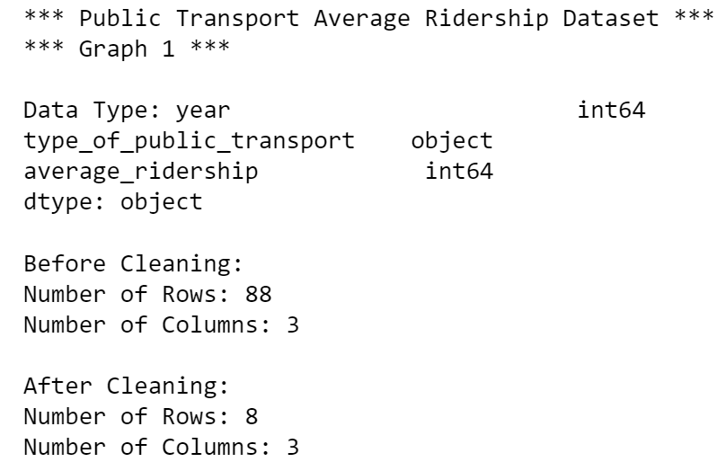
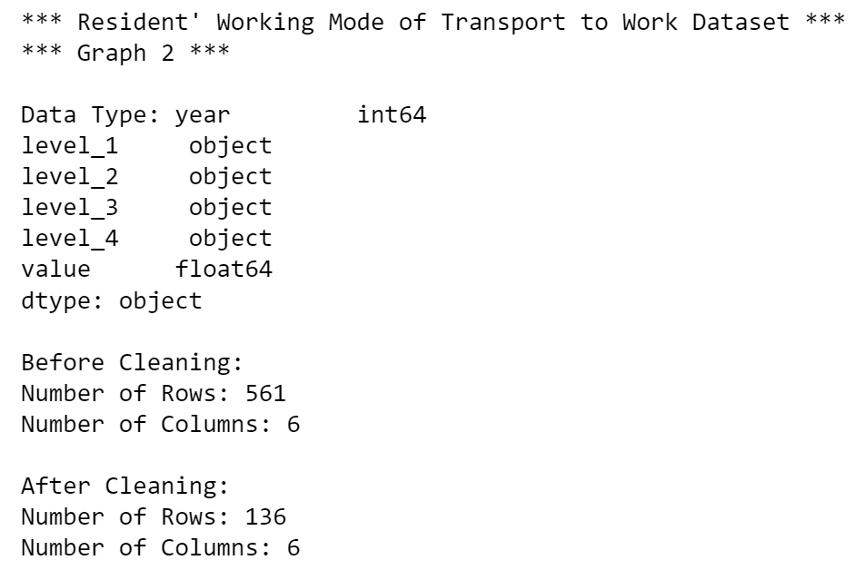
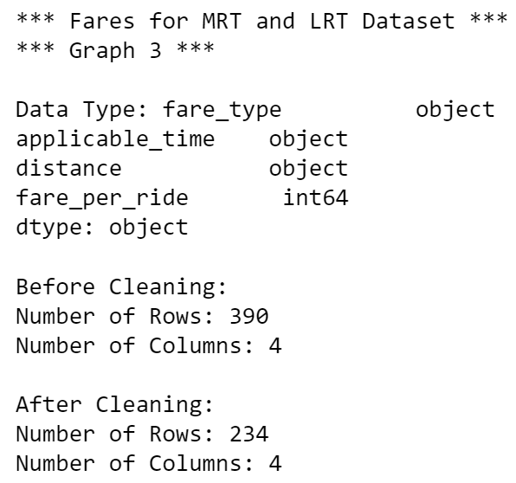
Nature of dataset
Graph 1
Graph 2
Graph 3

Slide 4
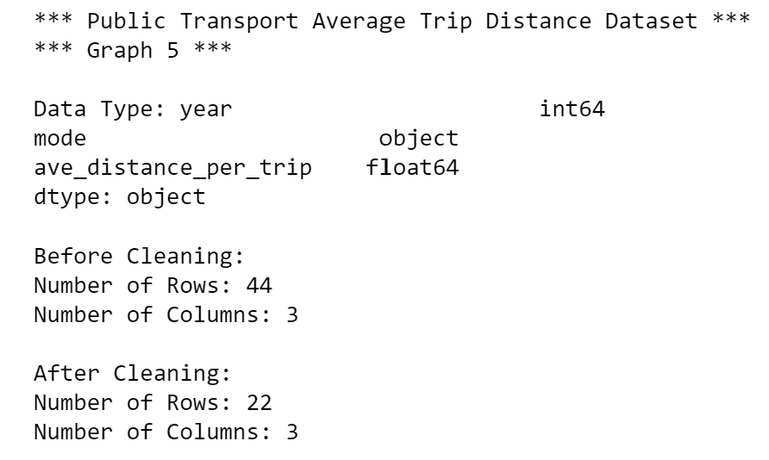
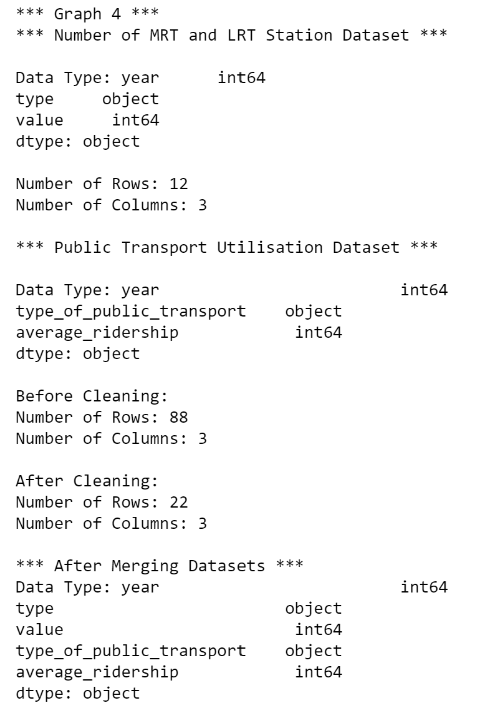
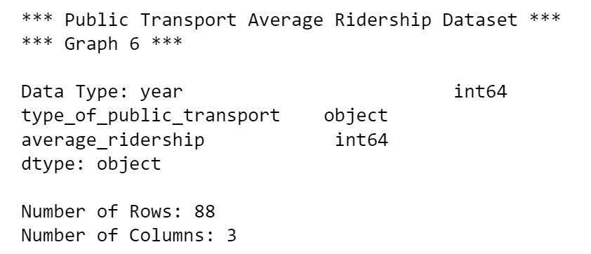
Nature of dataset
Graph 5
Graph 4
Graph 6

Slide 5
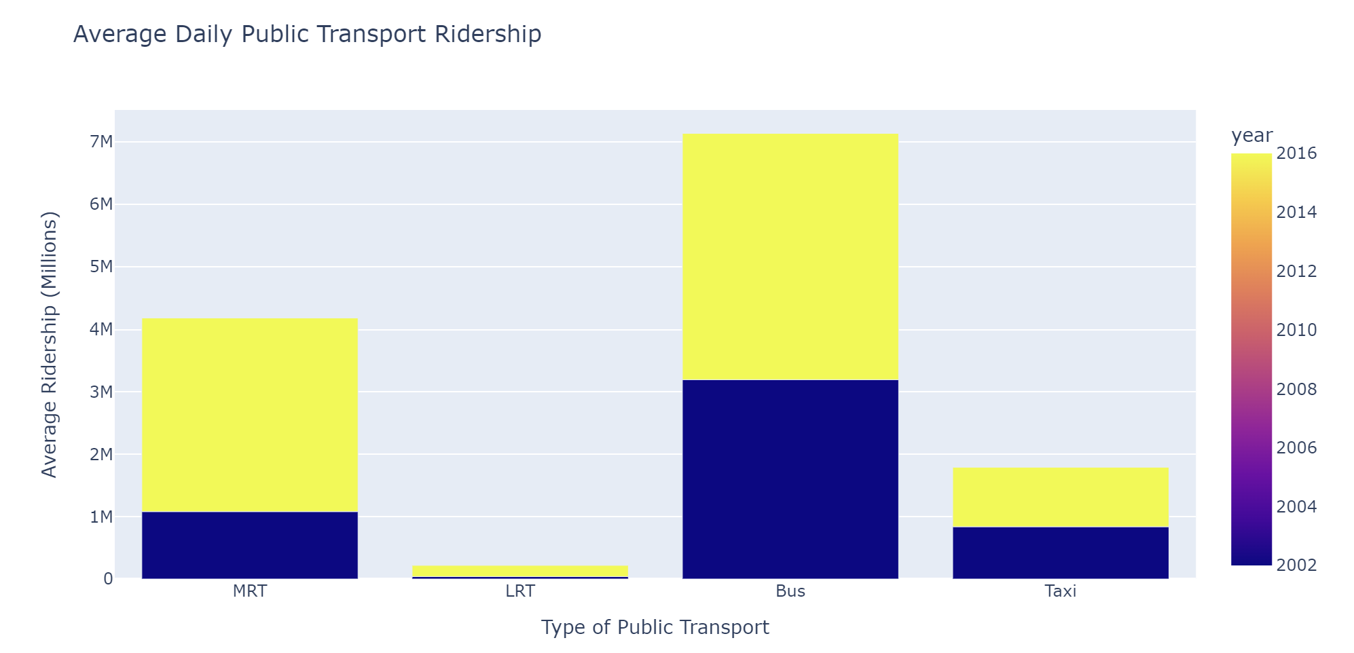
Objective 1: What is the current state of Singapore's land public transport situation like ?
Analysis
The graph suggests that the average daily public transport ridership across all forms of public transport increased from 2002 to 2016.
Mass Rapid Transport (MRT) ridership has nearly tripled from 1.08 million in 2002 to 3.1 million in 2016
The improvements in public transport’s connectivity around the island as more stations and lines are constructed is one of the many aspects contributing to the rise in public transport ridership.
Graph 1

Slide 6
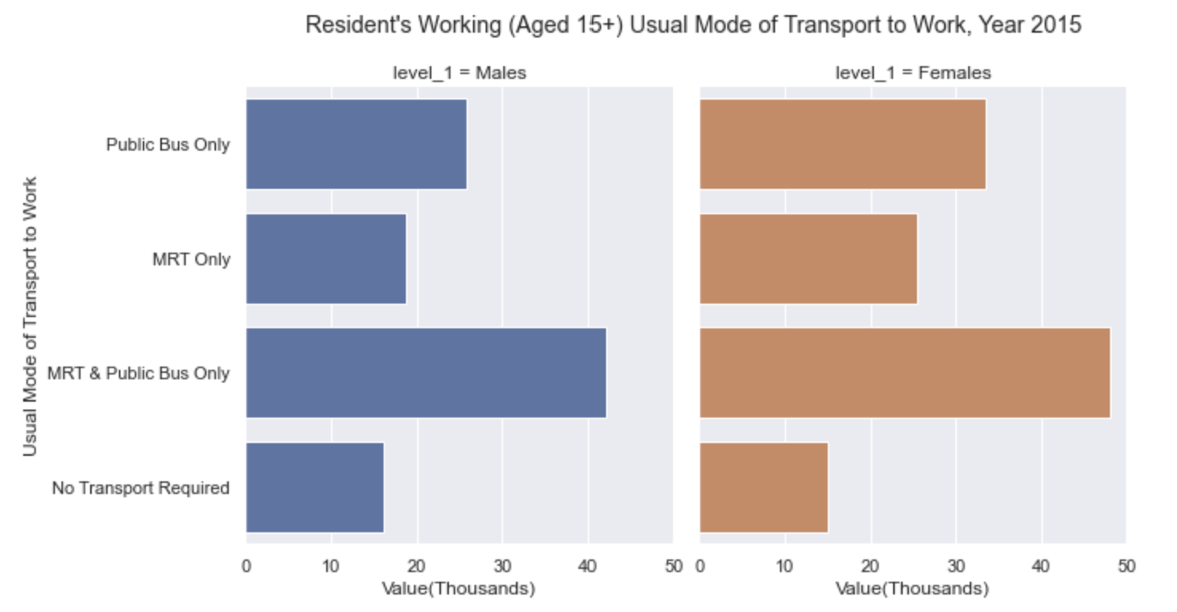
Objective 1: What is the current state of Singapore's land public transport situation like ?
Analysis
As shown from the highlighted portion in the FacetGrid, both genders group are equally reliant on the public transport system. (MRT & Public Bus)
The improved connectivity has result in the time taken to travel by public transport decreased and therefore comparable to the time taken by car.
Considering the time taken to travel by both methods are comparable, taking the cost into consideration, it is wise that citizens would opt to travel by public transport.
Graph 2

Slide 7
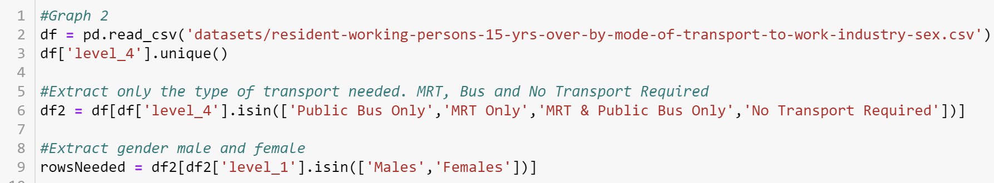
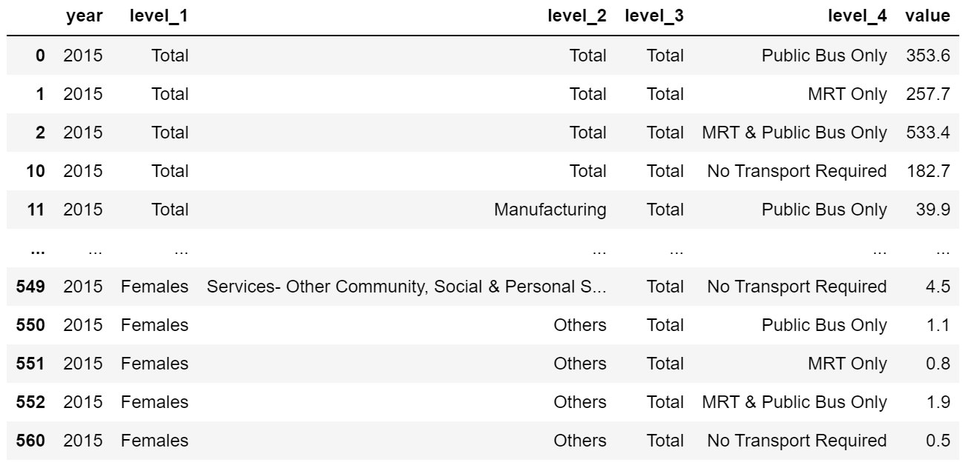
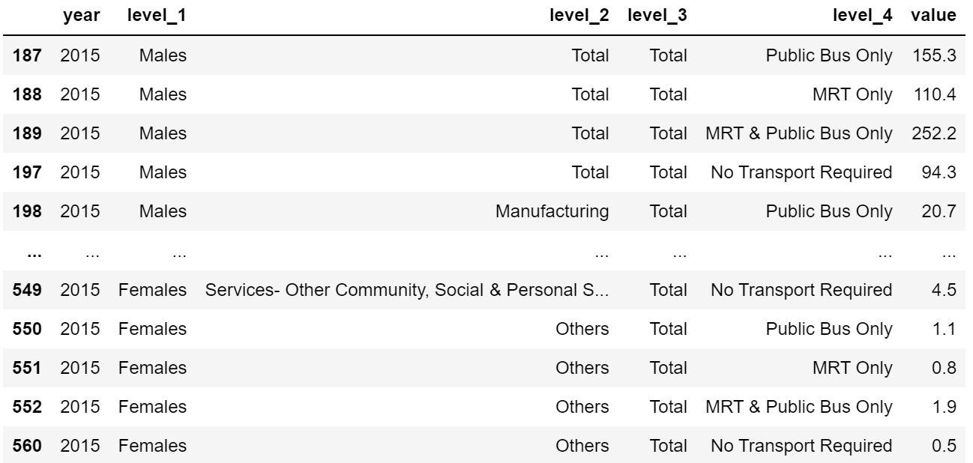
Cleansing of FacetGrid
Read the dataset with pd.read_csv
Extract only the rows needed with .isin
Further Extract the rows with gender Males and Females
Plot the FacetGrid
rowsNeeded:
df2:

Slide 8
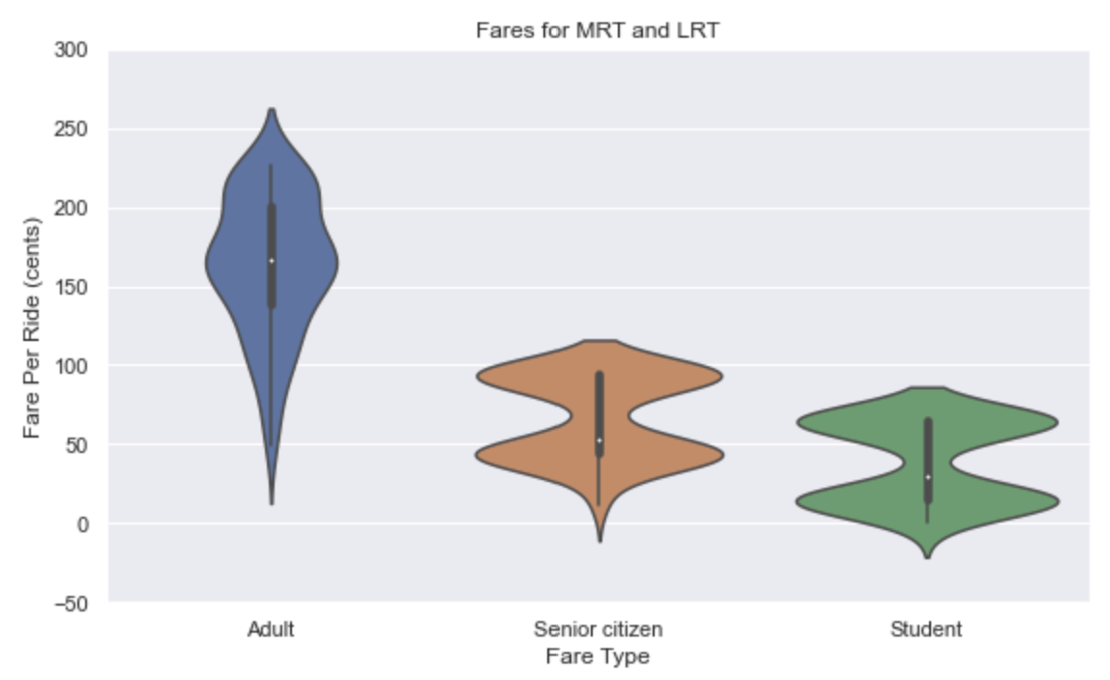
Objective 1: What is the current state of Singapore's land public transport situation like ?
Analysis
According to the violin chart, Median MRT and LRT transport fares for students is $0.285, compared to adult and senior citizen card fare of $0.1615 and $0.515 respectively. This makes traveling around Singapore highly affordable, encouraging citizens to travel by public transport.
On the other hand, an initiative known as Morning Pre-Peak Fares was introduced where citizens enjoy up to $0.50 savings in their transport fare should they enter the stations before 7:45am.
Citizens are monetary-incentivised to embark on their journey early which can concurrently regulate the morning crowd levels. As a whole, this would improve the rush hour crowd thus making the travel journey more comfortable for all.
Graph 3

Slide 9
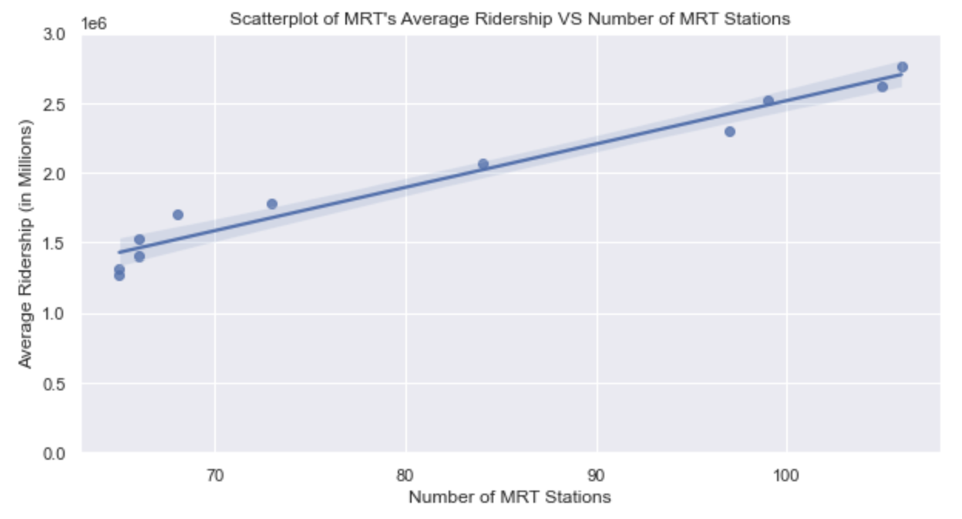
Objective 2: What are the steps that Singapore has taken to improve the comfort and accessibility of its public transport system? (Scatterplot)
Analysis
The scatterplot plotted shows a positive correlation between the average MRT’s ridership and the number of MRT stations.
This suggests that as the number of MRT stations constructed increases, more citizens are opting for the public transport system as their main mode of transport.
With more stations built in the heartlands of Singapore, it is no wonder that Singapore’s accessibility and connectivity to all parts of the island increased thus motivating citizen’s to utilise the transport system.
Graph 4

Slide 10
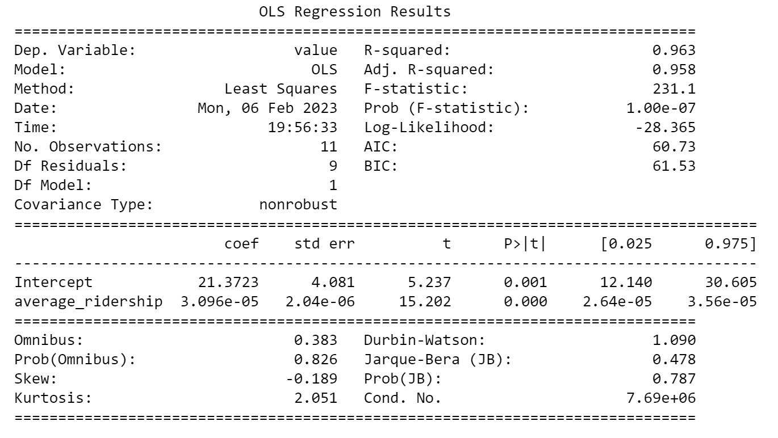
Objective 2: What are the steps that Singapore has taken to improve the comfort and accessibility of its public transport system? (Scatterplot Regression Result)
Analysis
The R Squared Value is 0.963 which indicates a positive corelation between the MRT’s average ridership and number of MRT Station built.
The more MRT Stations is being built, the higher the MRT’s average ridership will be

Slide 11
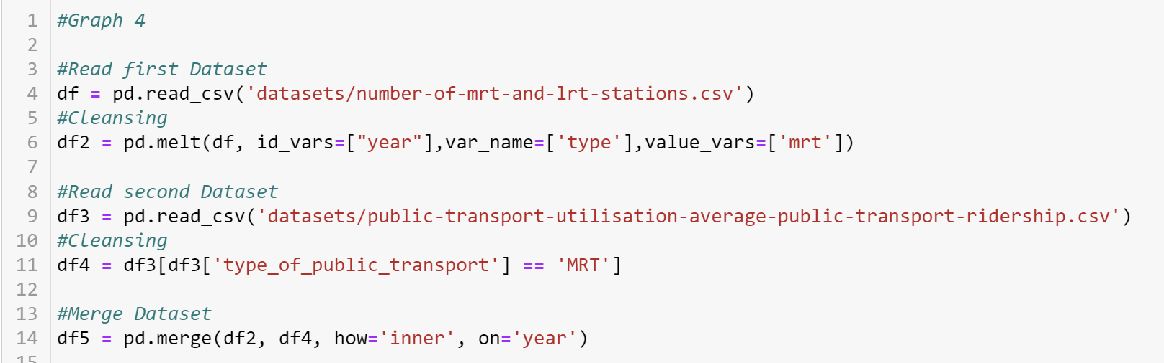
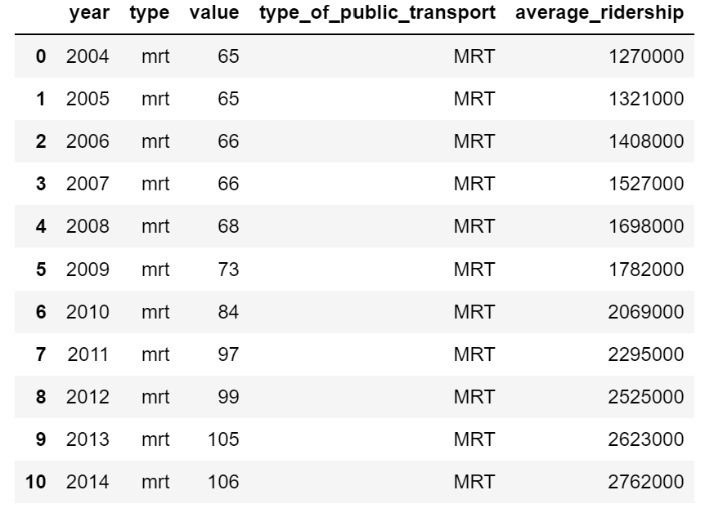
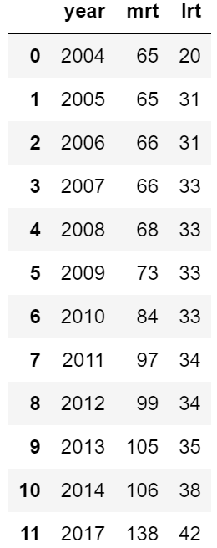
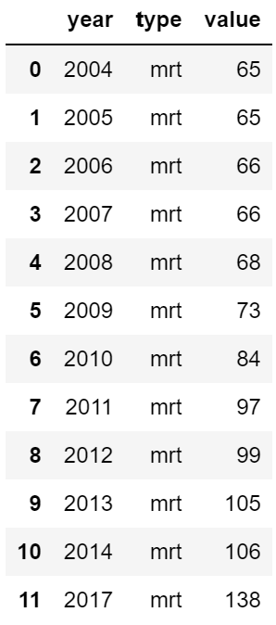
Cleansing of Scatterplot
After merging datasets:
Read first dataset
Used pd.melt to get values only for MRT
and group it under type column
Read second dataset
Extract rows that contain ‘MRT’
Merge the dataset on years
Plot the Scatterplot
After melt:
Before melt:

Slide 12
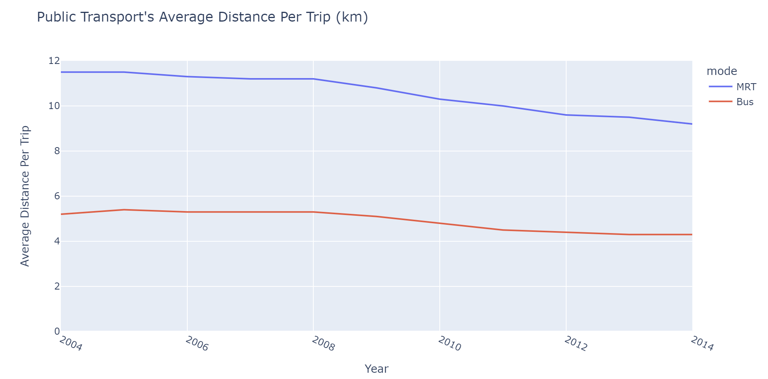
Objective 2: What are the steps that Singapore has taken to improve the comfort and accessibility of its public transport system?
Analysis
From the line chart, the average distance per trip for MRT decreased from 11.5km in 2004 to 9.2km in 2014 and Bus decreased from 5.2km in 2004 to 4.3km in 2014.
Commuters can expect to reach their destination faster due to shorter commuting time, which leads to increased productivity and better quality of life.
Graph 5

Slide 13
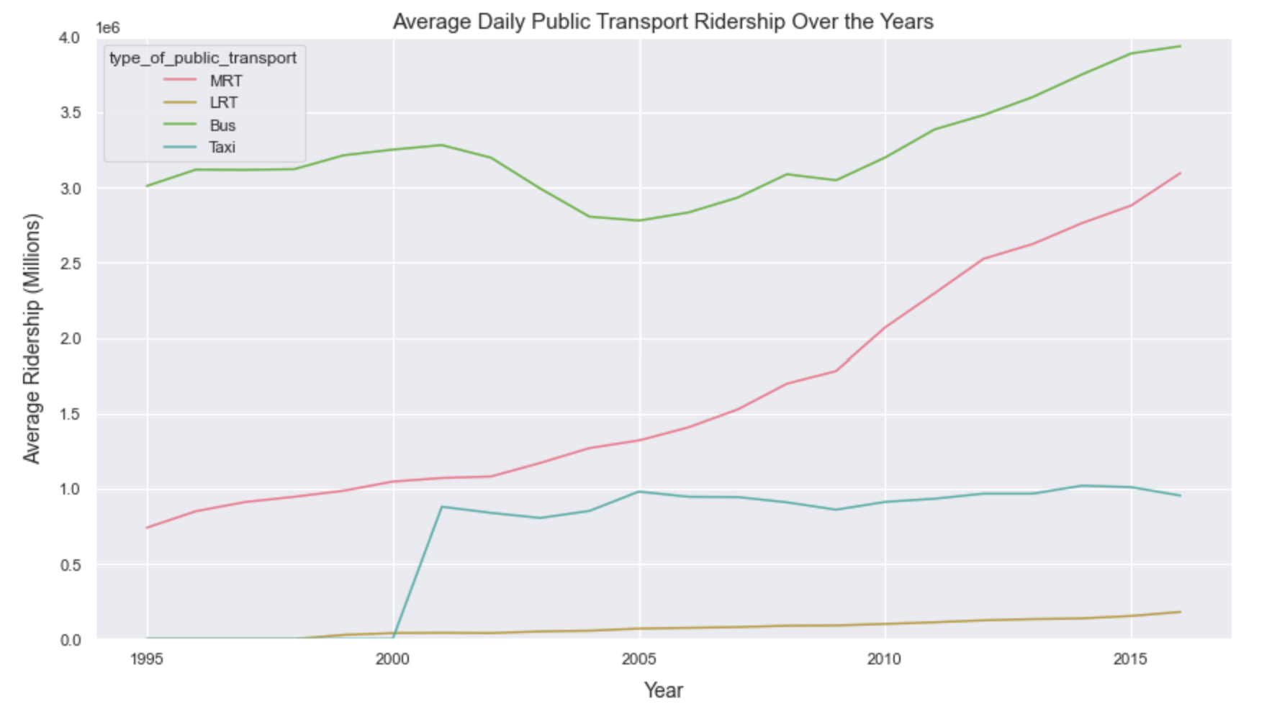
Objective 2: What are the steps that Singapore has taken to improve the comfort and accessibility of its public transport system?
Analysis
The graph suggests that the average daily public transport ridership across all forms of public transport except for Taxi increased from 2002 to 2016. On the other hand, ridership for taxi has fluctuated throughout this period .
Due to longer wait times for taxis to arrive and even costlier , More and more people are using the buses and MRT as their primary modes of transportation.
Besides, with more and more MRT stations and bus stops being built, it becomes even more convenient and increases citizen’s productivity. This will motivate citizens to utilize the MRT and bus even more
Graph 6

Slide 14
Conclusion: How successful is Singapore’s efforts in enhancing the efficiency of the nation’s land public transport?
To summarise my data analysis,
We can conclude that Singapore is successful and have made tremendous effort in enhancing the efficiency of the nation’s land public transport. Through constantly building more MRT, LRT Stations and Bus Stops, introducing Morning Pre-Peak Fares and constantly making public transport system more accessible.
There have been positive results & feedbacks shown through statistics and cultural norms.
Recommendations:
Moving forward,
Maintenance Check-Ups can be done more often for train services. Commuter’s overall satisfactions dipped in 2021 due to train breakdowns which attributes to train delays which resulted in longer waiting time.
Increasing the number of buses and trains to provide more frequent and timely service

Slide 15
References
Public Transport Average Ridership Dataset: https://data.gov.sg/dataset/public-transport-utilisation-average-public-transport-ridership
Resident’s Working Mode of Transport to Work Dataset: https://data.gov.sg/dataset/resident-working-persons-aged-15-yrs-over-by-usual-mode-of-transport-to-work-industry-sex-2015?view_id=544b0a7a-6539-4b73-a2ee-107b2be3a30c&resource_id=ad7f7a65-12af-48d4-9d43-cf69065461f5
Fares for MRT and LRT Dataset: https://data.gov.sg/dataset/fare-structure-mrts-and-lrts
Number of MRT and LRT Dataset: https://data.gov.sg/dataset/number-of-mrt-lrt-stations
Public Transport Average Trip Distance Dataset: https://data.gov.sg/dataset/public-transport-utilisation-average-trip-distance

